Slide 1
Syria’s Toxic War on Itself
Presented by Team TED.py
JOUR7280 Big Data Analytics for Media and Communication
April 27th, 2018

Slide 2
Content
Introduction
Syria: The Land of Blood And Detachment
Alleged Russian Attacks

Slide 3
Introduction of Datasets
A media documentation -- The Syrian Archive Dataset
It maintains an extensive video database of all known allegations in which civilians have been reported killed or injured since 2014 to present.
A recorded death list -- The Violations Documentation Center in Syria is one of the largest human rights organisations established in 2011 with staff members and contacts in all governorates and most cities inside Syria.

Slide 4
Timeline
Jan, 2016 |  |  |  | Apr, 2018
The truce agreement
Russian response
If all parties abide by the agreement?
Missile attacks
America
Britain
France

Slide 5
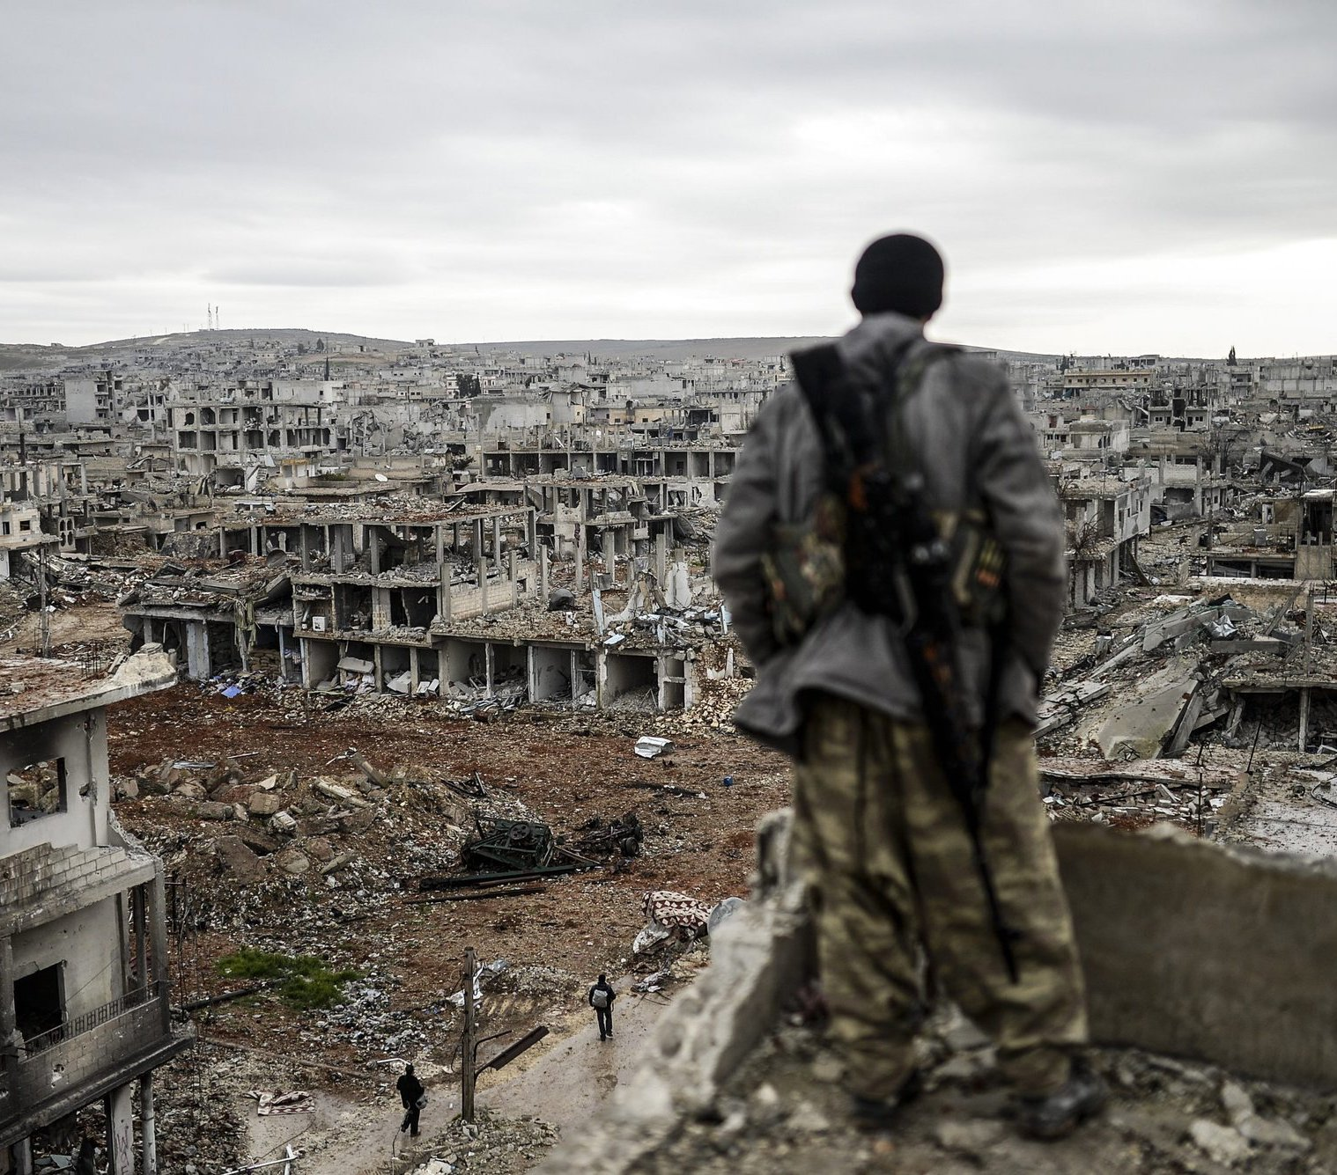
Syria:
In the Land
Of Blood
And
Detachment
Over 7 years
465,000 people died
More than 12 million refugees
Musa, a 25-year-old Kurdish sniper, on top of a building in the destroyed town of Kobani, also known as Ain al-Arab, in Syria in January 2015. Bulent Kilic/Agence France-Presse — Getty Images

Slide 6
From the Syrian Archive Database
And the Violations Documentation in Syria:
Death-Location
Chemical Weapon
Actors-Civilians
Aleppo and Idlib rank the tops in both the documentations, most violations the media reported and the death list.
Aleppo and Idlib are the two most disputed regions. The Syrian regime and its allies concentrate on.
The Syrian regime use chemical weapons constantly in the civil war.
Chemical weapons take up 0.74% in the Violations Documentation in Syria as the leading cause of death. But 29.94% in the Syrian Archive.
Syrian government, Syrian regime, ISIS, Iran, Russia and the American mess the confusion of Syria.
Followed by the top butcher, Syrian government, the Russian troops killed 3,651 civilians out of 3,808 victims.

Slide 7
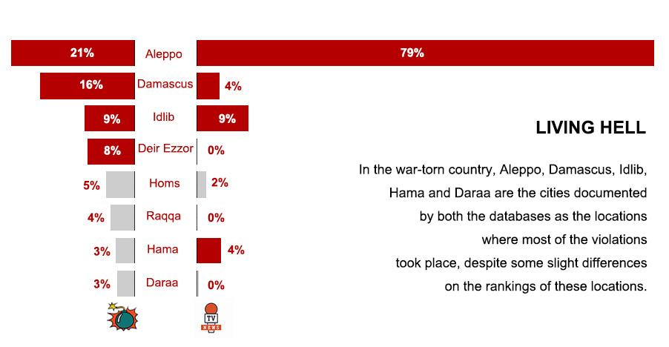
Living Hell in Syria
Aleppo, Damascus, Idlib, Hama and Daraa are the cities documented by both the databases as the locations where most of the violations took place,

Slide 8
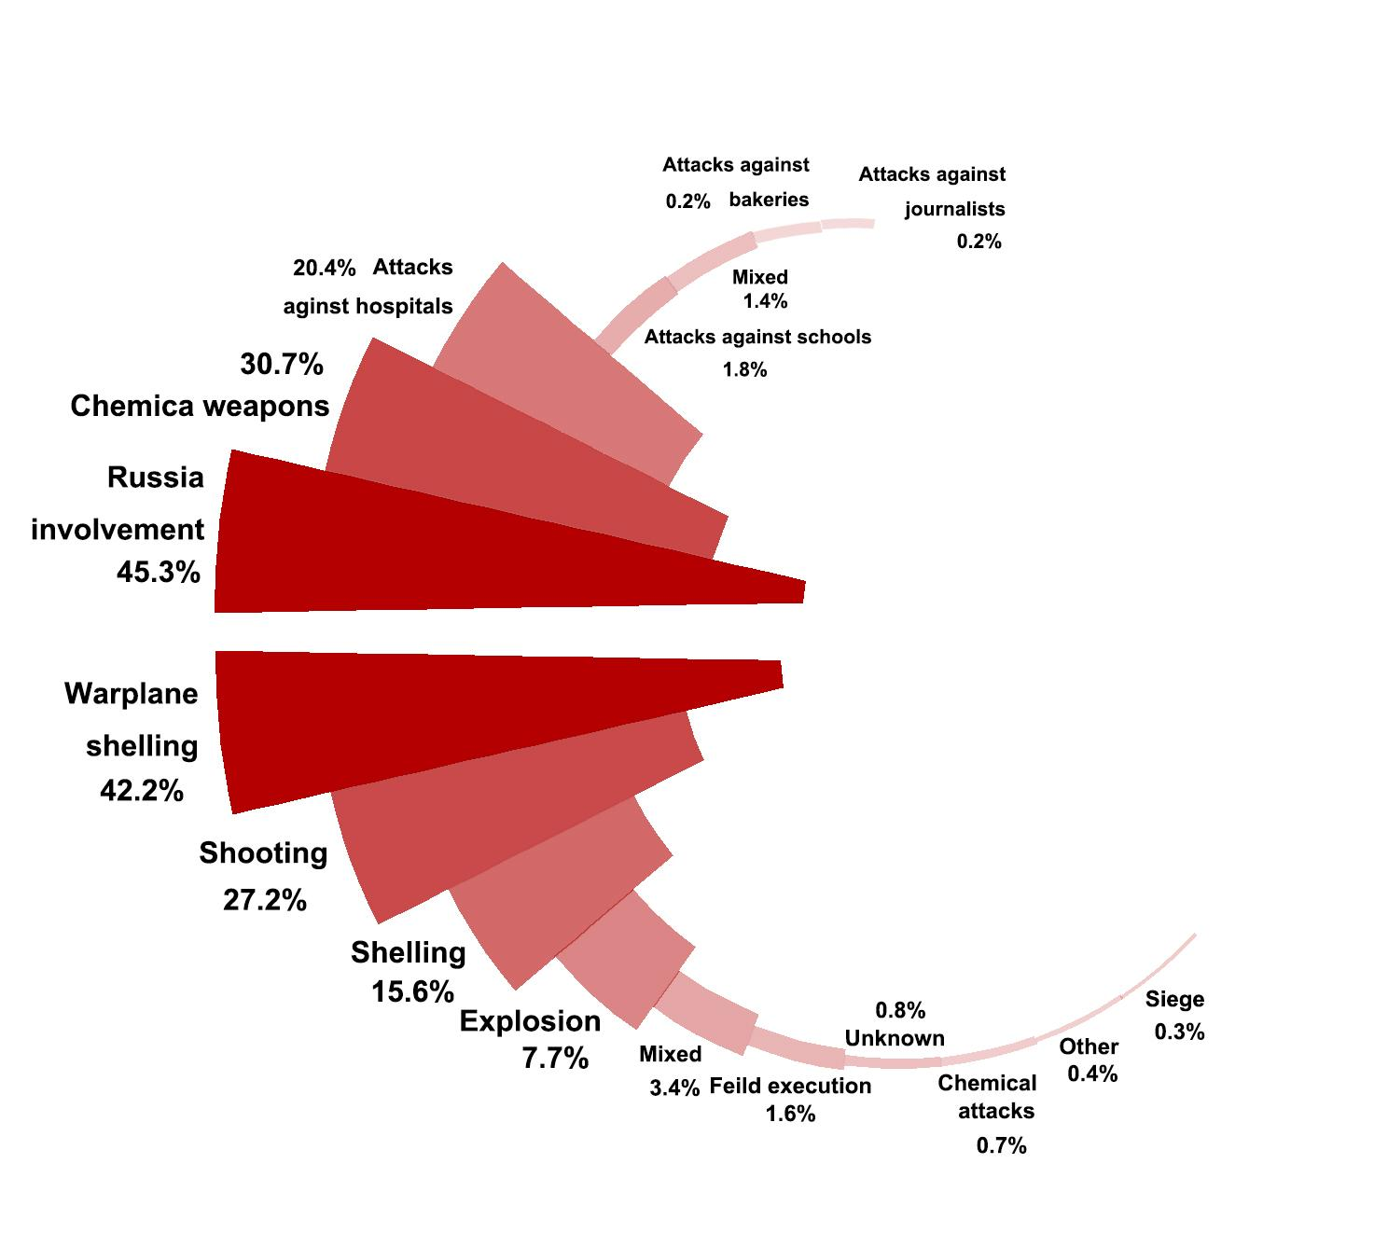
Chemical Weapons:
Excuse or Reality?
Death List
warplane shelling
(12,926)
shooting (8348)
Eighth:
chemical weapons,
I.e. chemical and toxic gases (226)
Media Record
Second: 29.94% violations

Slide 9
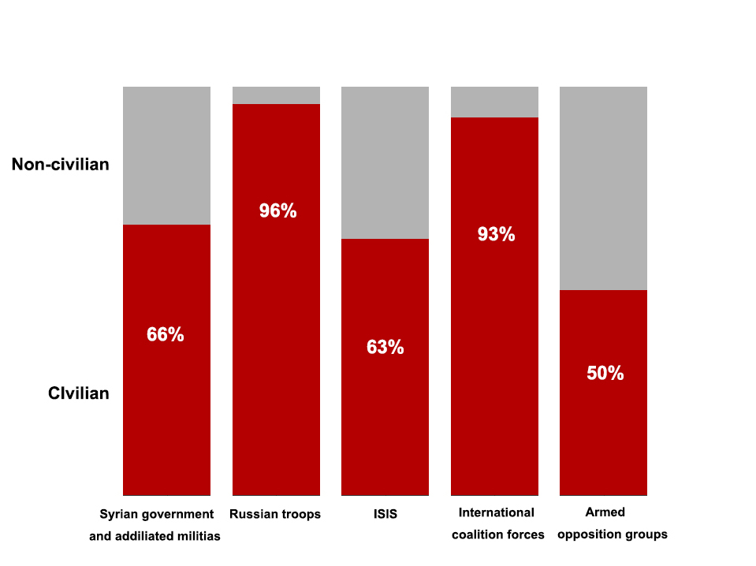
15,558
3,808
3,102
2,059
1,634
Who are killing people?
Top: Syrian government
-- 66.26% civilians
Second: Russian troops
-- 95.88% civilians
Third: ISIS
-- 62.86% civilians

Slide 10
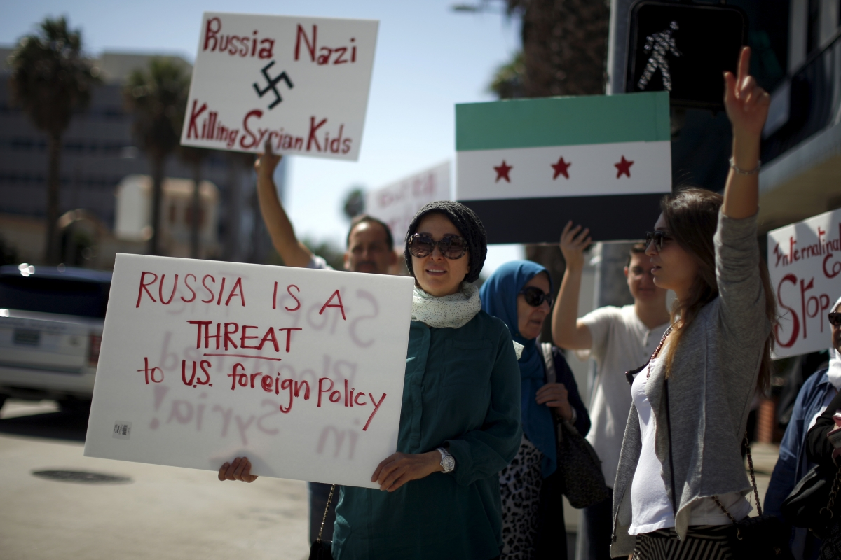
Why Russian troops
are frequently mentioned with Syria violation

Slide 11
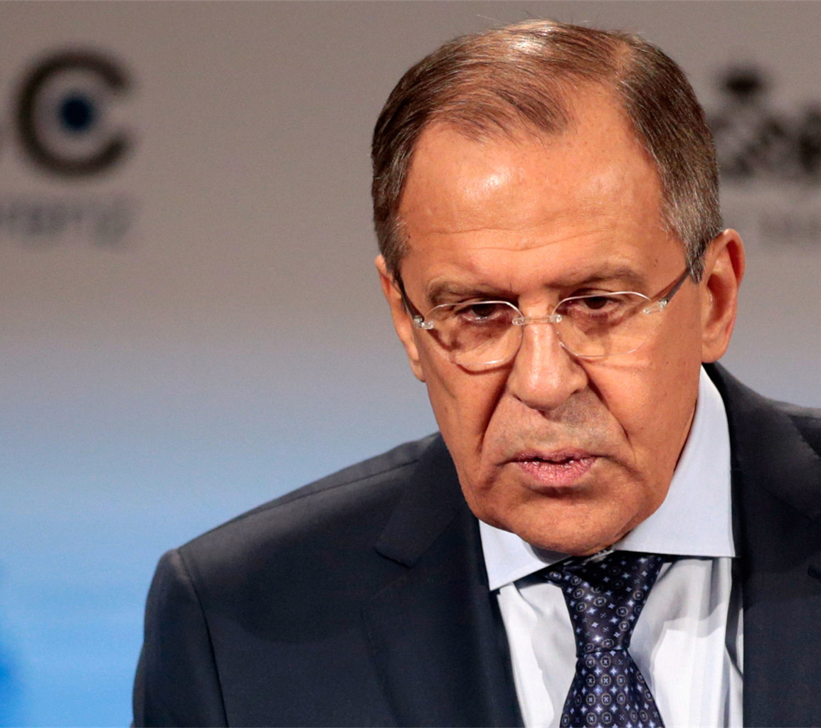
Russia’s Response
To
Syrian Incident
Sergei Lavrov,
Russian Foreign Minister told BBC in an interview on April 16th that
Russia must do “whatever is required to help the Syrian army deter aggression”.

Slide 12
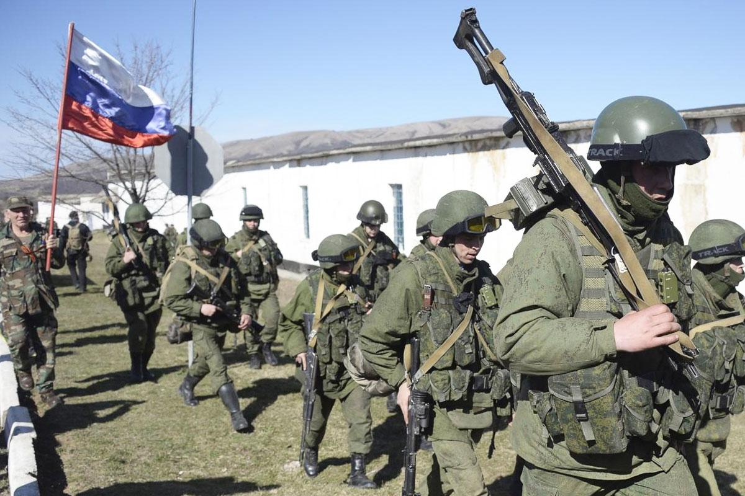
The Myriad Connection
Russia’s intervention in the Syrian Civil War began long before:
September 2015
Islamic State has lost swathes of Syrian territory to the Syrian army and its allies.
(Source: Reuters)

Slide 13
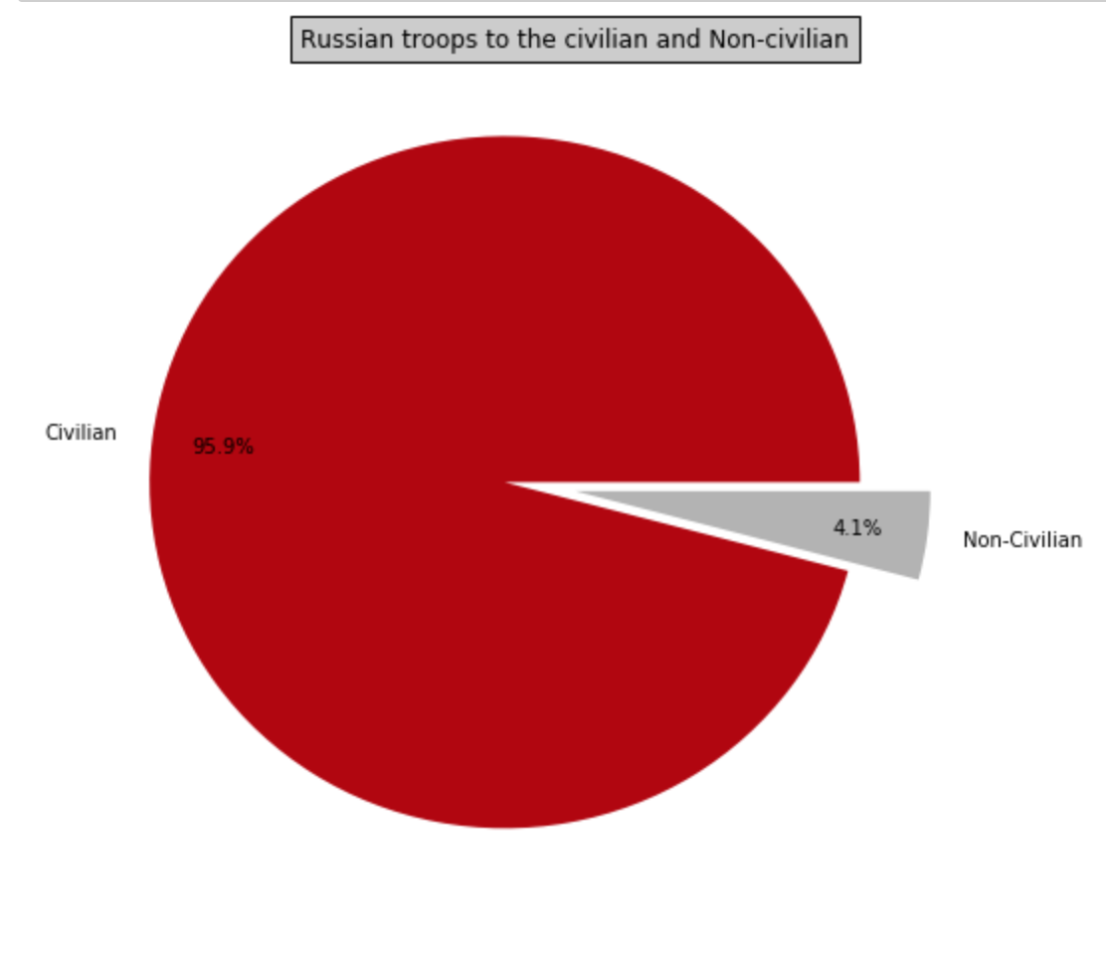
Feature One
Indiscriminate Attacks
The Russian troops committed 3,808 murders in the past two years with a striking proportion of civilians being 95.88% (3,651), which means only one out of the 23 killings was targeted against non-civilian.

Slide 14
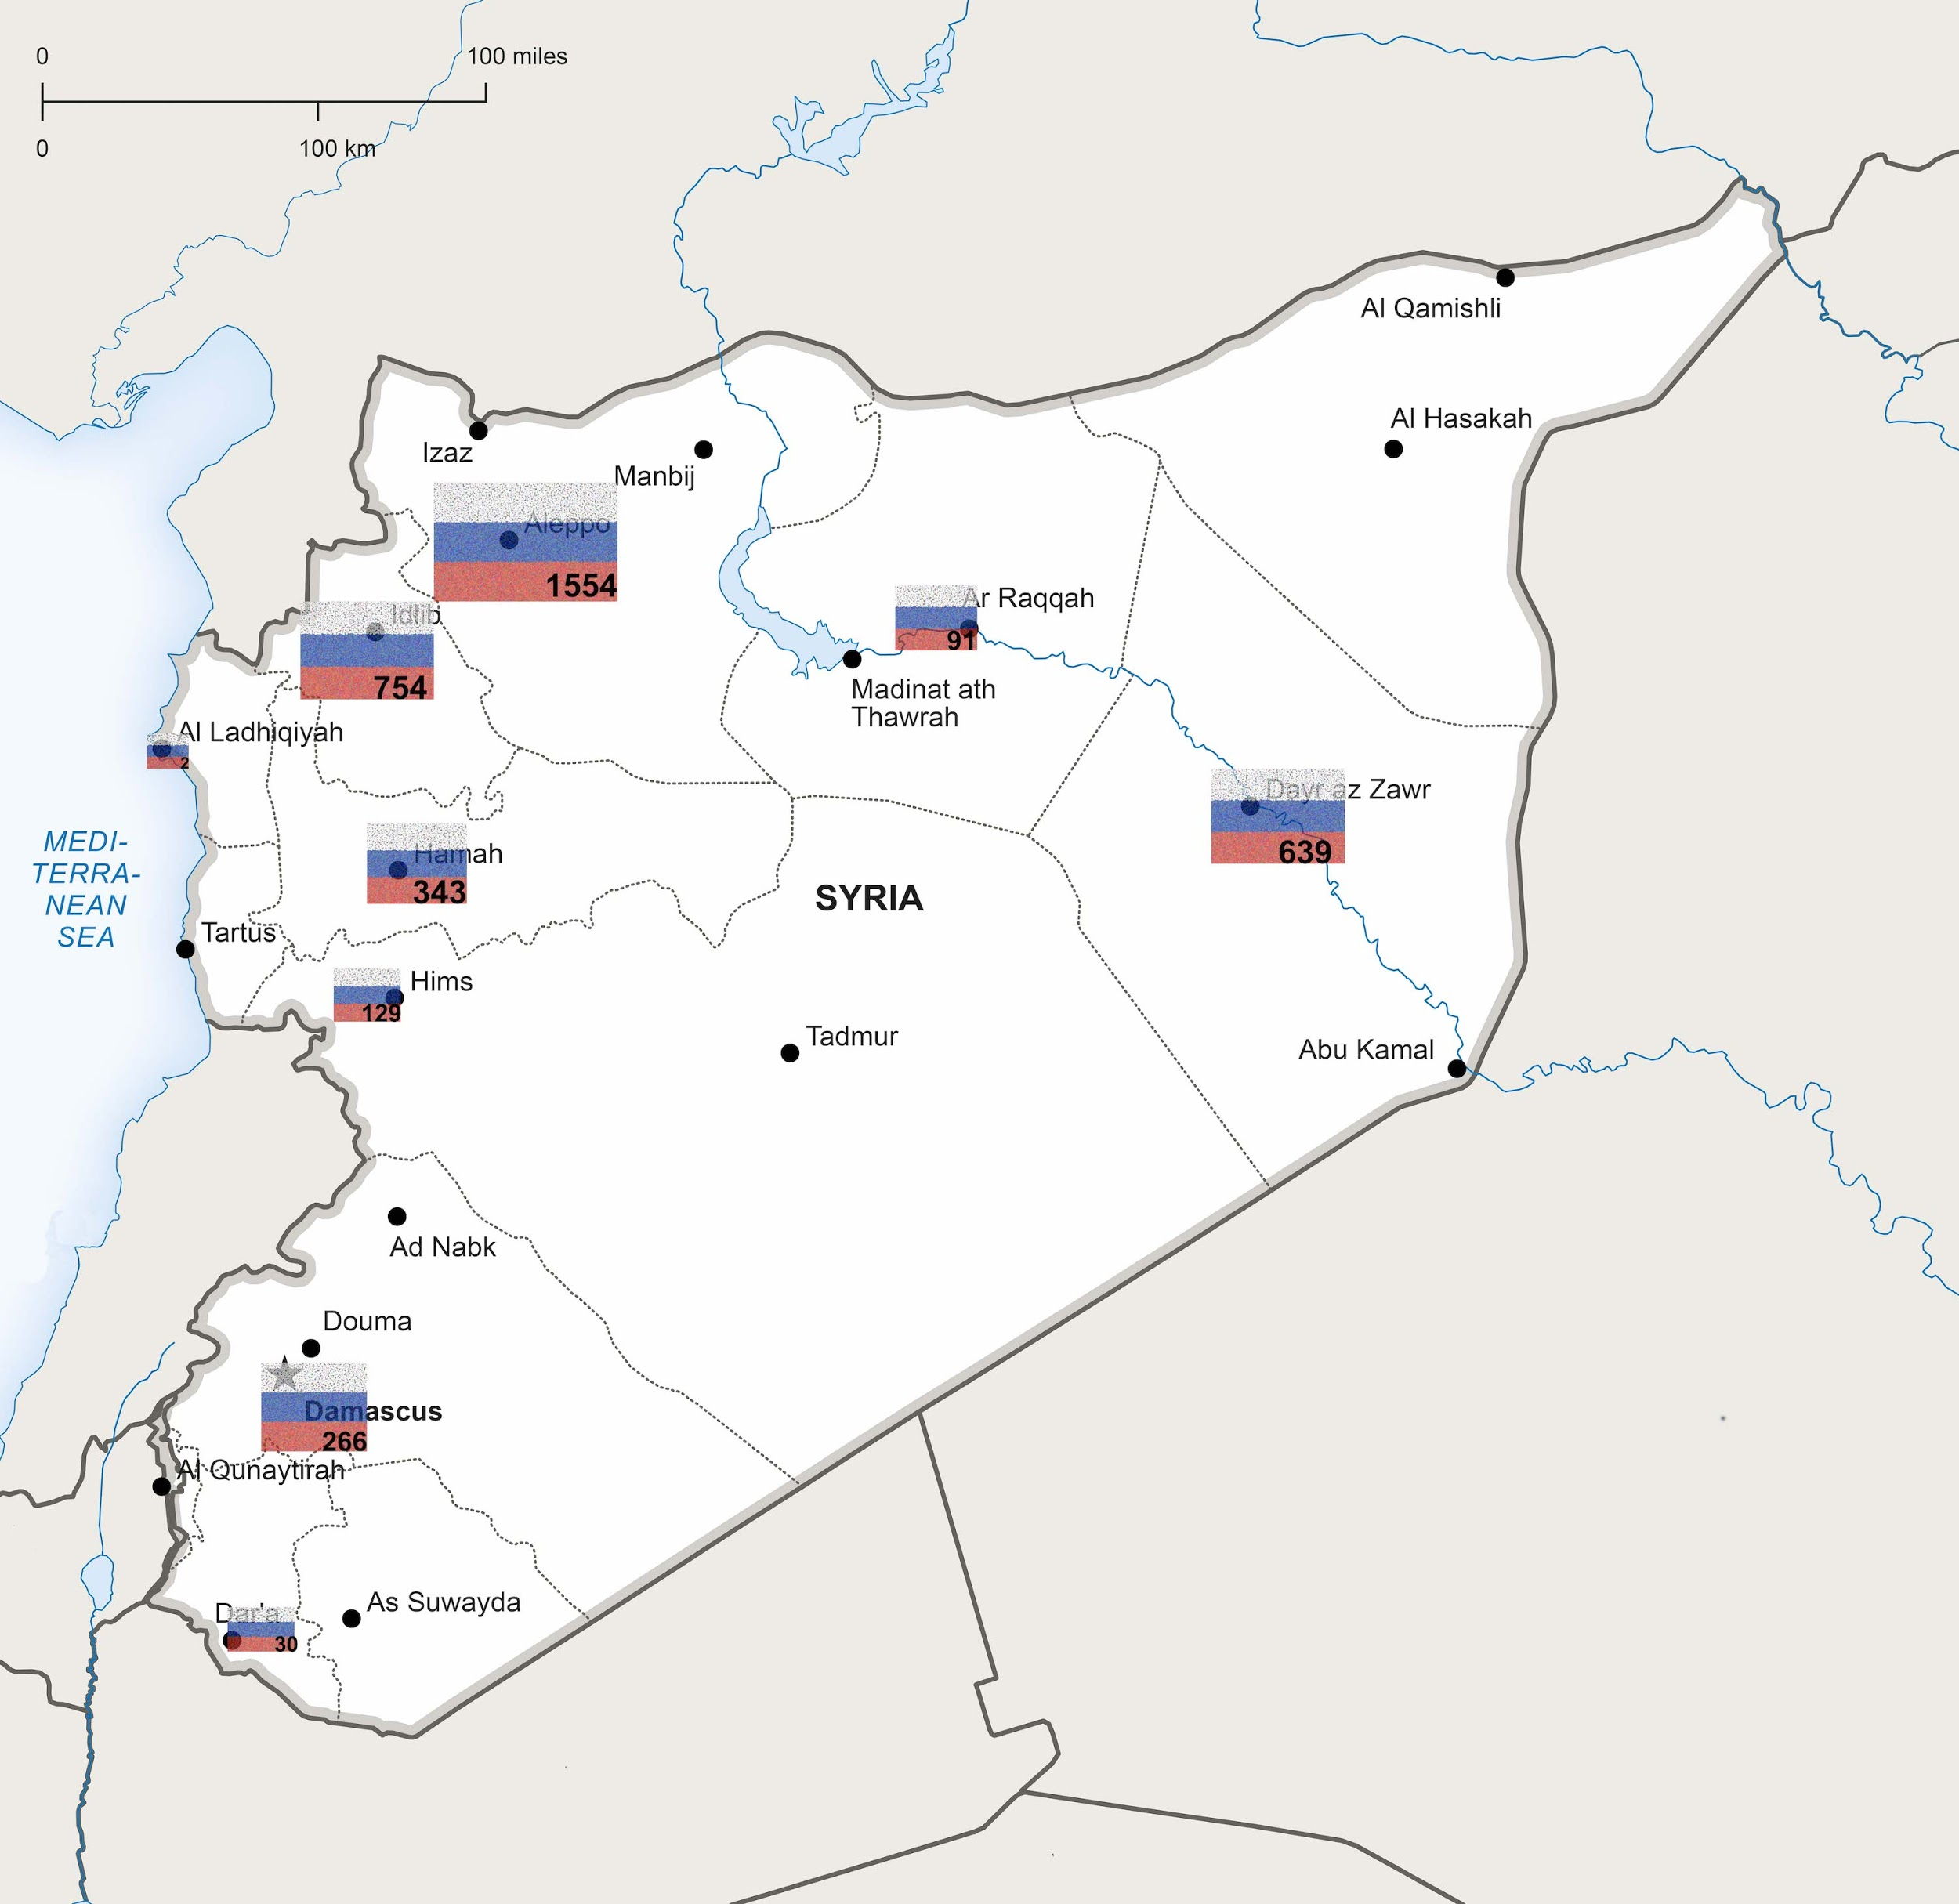
Feature Two
Well-Targeted Locations
Russian munitions have been
well-targeted at locations where they held the largest benefits.
Aleppo (1,554)
Idlib (754)
Deir Ezzor (639)

Slide 15
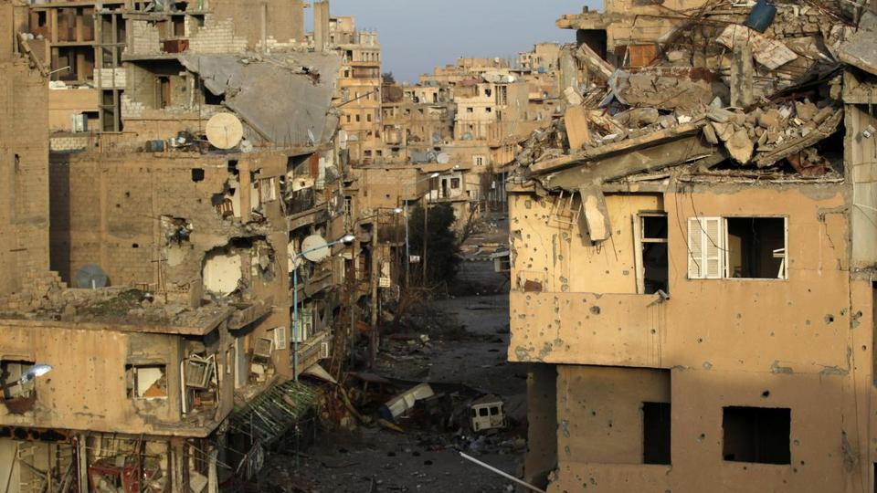
A Strategic City
Deir Ezzor
Deir Ezzor, for example, is recorded as the city where most lives (65 lives) were taken by the Russia.
A domestic and international terminal
Behind the Game:
Russia-and-Iran-backed regime vs. US-backed People’s Protection Units

Slide 16
Untraceable Trade
1
Turkey ($1.38B)
In 2015, the products exported from Russia to Syria contain more than a quarter of arms and ammunition, which has no presence in any of the other four countries’ exports.
2
China ($1.02B)
3
Egypt ($237M)
4
SKorea ($209M)
5
Russia ($186M)
(Source: Observatory of Economic Complexity)

Slide 17
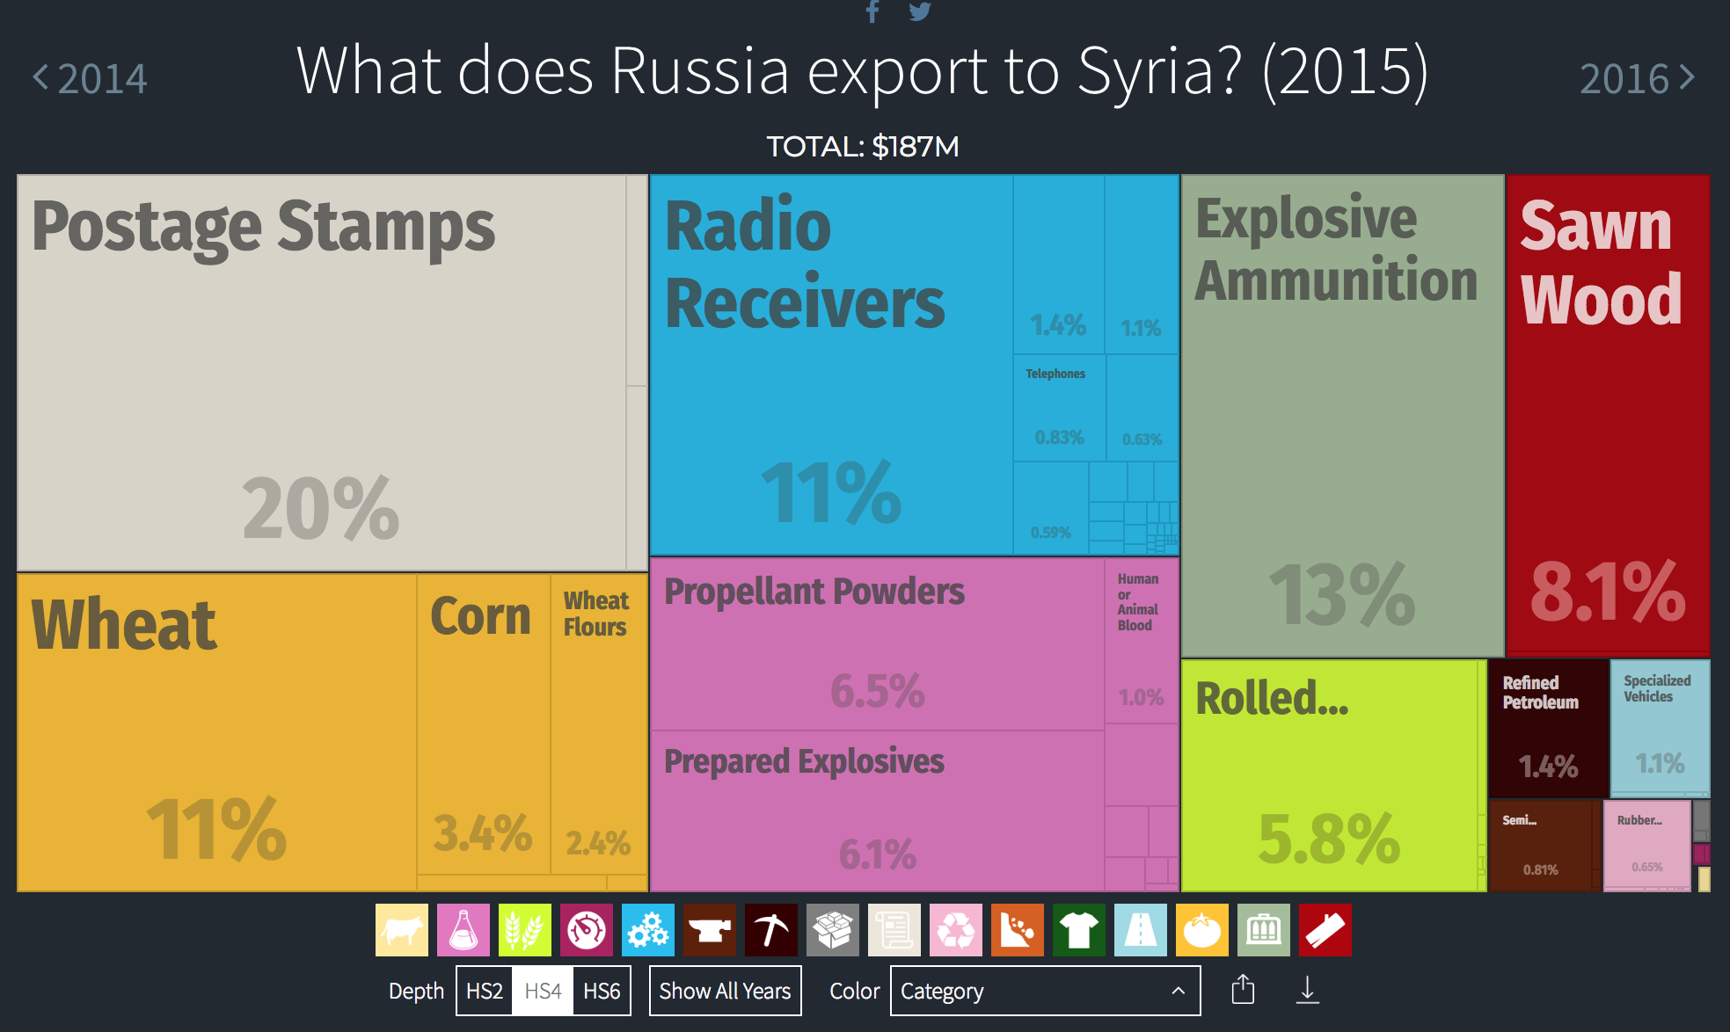
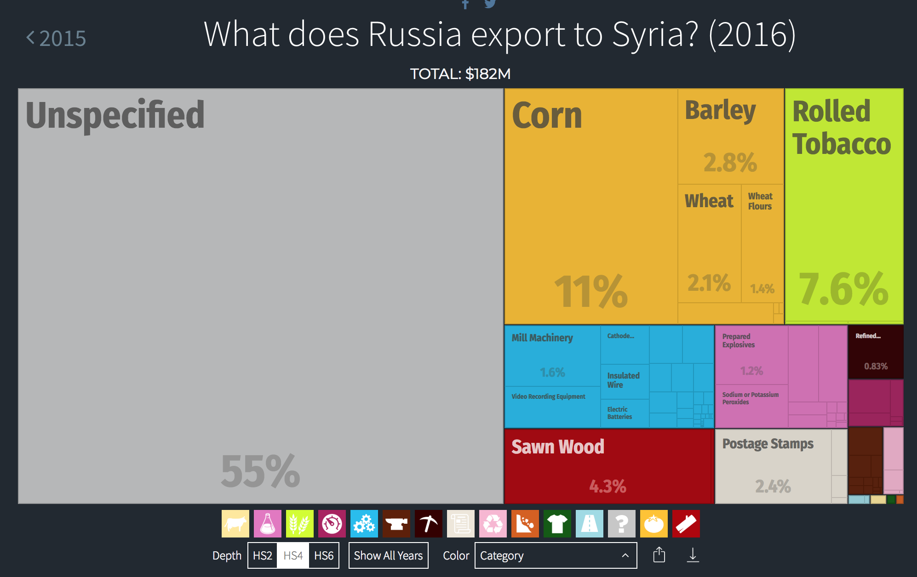
(Source: Observatory of Economic Complexity)
For the trade records in 2016, only 1.2 percent of prepared explosive is presented, while a chunk of gray area (55 percent) is shown in the graph, tagging with “Unspecified”.

Slide 18
Conclusion

Slide 19




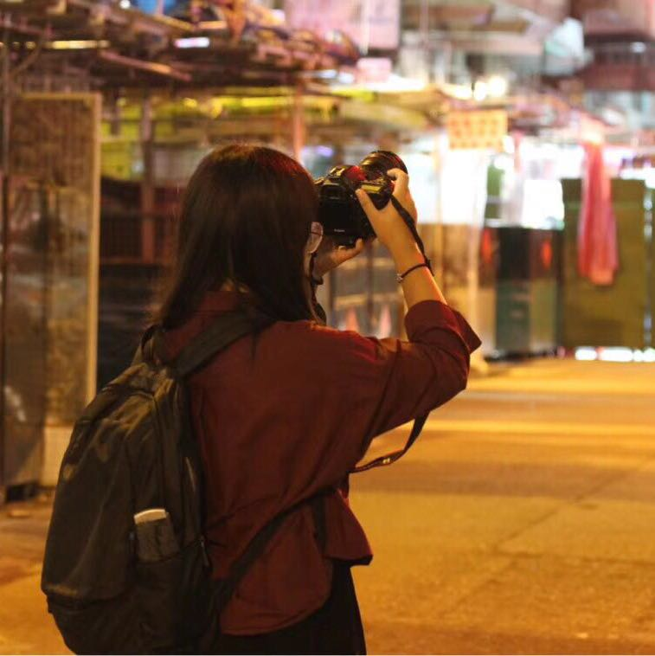
Our Team: TED.py
Eudora Wang
Tiffany Leung
Pragya Bhatnagar
Vera Yan
Daisy Zhong
Reporting on Russia’s intervention
Reporting on the general violations in Syria
Editor
Data scraping & visualization
Data scraping & visualization

